Slide 1
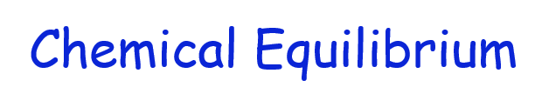
CHM 101
ABDULLAHI Danjuma Kassim

Slide 2
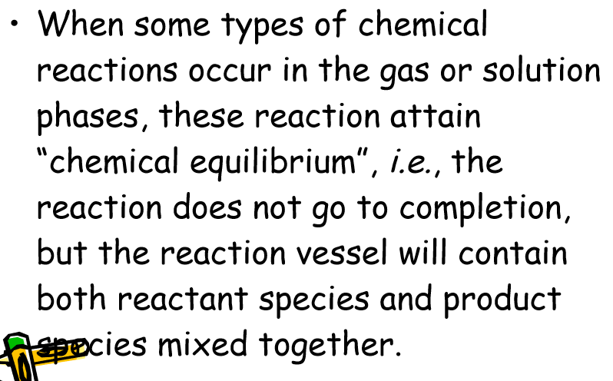

Slide 3
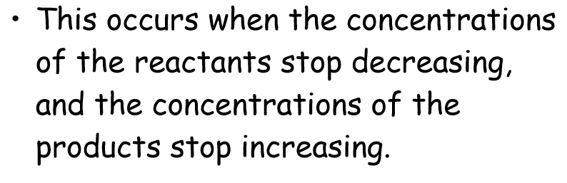




Slide 4
Many chemical reactions do not go to completion but instead attain a state of chemical equilibrium.
Chemical equilibrium: A state in which the rates of the forward and reverse reactions are equal and the concentrations of the reactants and products remain constant.
⇒ Equilibrium is a dynamic process the conversions of reactants to products and products to reactants are still going on, although there is no net change in the number of reactant and product molecules. For the reaction: N2O4(g) ↔ 2NO2(g)

Slide 5

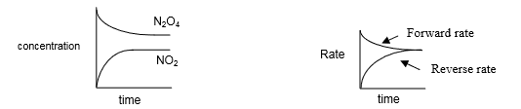


Slide 6
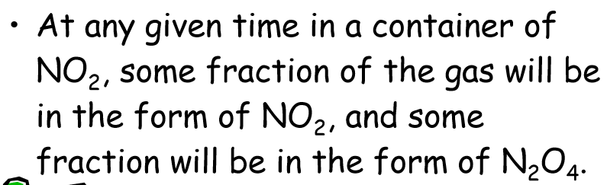
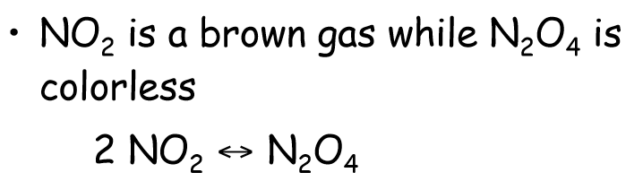

Slide 7
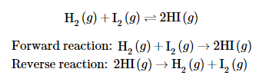
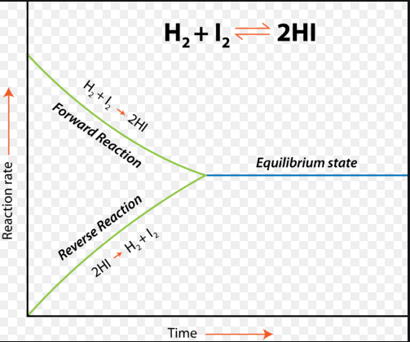
Hydrogen and iodine gases react to form hydrogen iodide according to the following reaction:

Slide 8
Initially, only the forward reaction occurs because no HI is present.
As soon as some HI has formed, it begins to decompose back into H2 and I2.
Gradually, the rate of the forward reaction decreases while the rate of the reverse reaction increases. Eventually the rate of combination of H2 and I2 to produce HI becomes equal to the rate of decomposition of HI into H2 and I2.
When the rates of the forward and reverse reactions have become equal to one another, the reaction has achieved a state of balance.
Chemical equilibrium is the state of a system in which the rate of the forward reaction is equal to the rate of the reverse reaction.

Slide 9
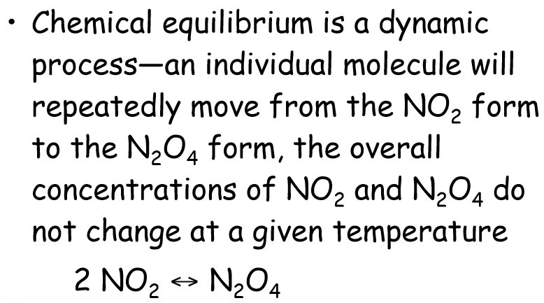

Slide 10
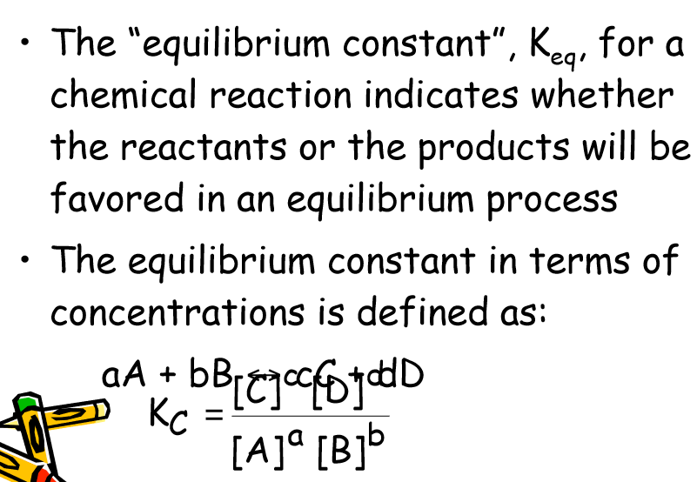

Slide 11

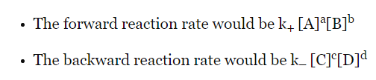
Equilibrium Constant
Law of mass action also forms the basis which states that the rate of a chemical reaction is directly proportional to the product of the concentrations of the reactants raised to their respective stoichiometric coefficients. Therefore, given the reaction –
By using the law of mass action here,

Slide 12

Equilibrium Constant
where, [A], [B], [C] and [D] being the active masses and k₊ and k₋ are rate constants of forward and backward reactions, also the a, b, c, d are the stoichiometric coefficients related to A, B, C and D respectively. However, at the equilibrium – the forward and the backward rates are equal, stating –
Rate of forward reaction = Rate of backward reaction

Slide 13
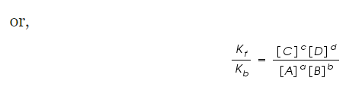
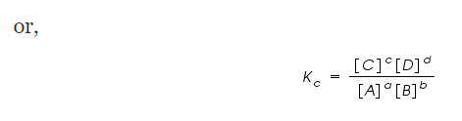
Equilibrium Constant

Slide 14
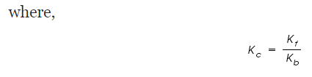

Equilibrium Constant

Slide 15
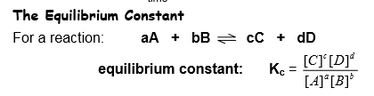
Law of mass action - The value of the equilibrium constant expression, Kc, is constant for a given reaction at equilibrium and at a constant temperature. ⇒ The equilibrium concentrations of reactants and products may vary, but the value for Kc remains the same.

Slide 16

Equilibrium Constant

Slide 17
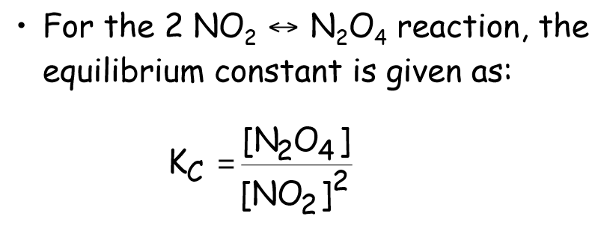

Equilibrium Constant

Slide 18
Reaction Quotient
The reaction quotient, Q, is used when questioning if we are at equilibrium. The calculation for Q is exactly the same as for KK but we can only use K when we know we are at equilibrium. Comparing Q and K allows the direction of the reaction to be predicted.
Q = K equilibrium
Q < K reaction proceeds to the right to form more products and decrease amount of reactants so value of Q will increase.
Q > K reaction proceeds to the left to form more reactants and decrease amount of products so value of Q will decrease.

Slide 19
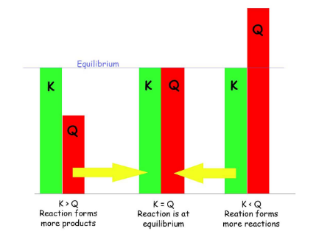
How the Gas Equilibrium Constants Relate to Reaction Quotient (Q)
The process of finding the Reaction Quotient (Q_{c}) is the same as finding K_{c} and K_{p}, where the products of the reaction is divided by the reactants of the reaction (Products/Reactants) at any time not necessarily at equilibrium.

Slide 20

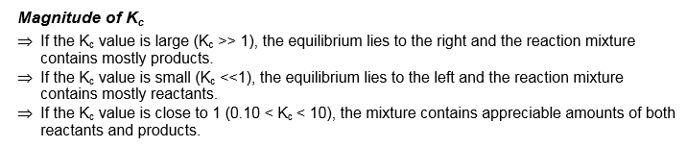
Equilibrium Constant

Slide 21
WHAT DOES THE EQUILIBRIUM CONSTANT TELL US?
If a problem asks you to find which way the reaction will shift in order to achieve equilibrium, and K is given, you would have to calculate for Q and compare the two numbers. When comparing K and Q:
K < Q : Since there are more products than reactants, the reaction will produce more reactants to reach equilibrium, the reaction favors the reactants.
K > Q : Since there are more reactants than products, the reaction will produce more products to reach equilibrium, the reaction favors the products.
K = Q : There is no change in the products nor reactants, so equilibrium is achieved.

Slide 22
WHAT DOES THE EQUILIBRIUM CONSTANT TELL US?
Predicting the Direction of Reaction
The reaction quotient, Q, is the resulting value when we substitute reactant and product concentrations into the equilibrium expression.
If Q > K, the reaction will go to the left.
• The ratio of products over reactants is too large & the reaction will move toward equilibrium by forming more reactants.
2. If Q < K, the reaction will go to the right.
• The ratio of products over reactants is too small & the reaction will move toward equilibrium by forming more products.
3. If Q = K, the reaction mixture is already at equilibrium, so no shift occurs.

Slide 23
How the Gas Equilibrium Constants Relate to Reaction Quotient (Q)
A trick to remember to which what the reaction will favor is:
Put: K _ Q (in alphabetical order! - or it will not work)
K < Q : K ←← Q
The reaction will favor the reactants because reactants are on the left of the equation. K > Q : K →→ Q
The reaction will favor the products because products are on the right of the equation. K = Q : NO CHANGE

Slide 24
Work Out Example
Example. For the reaction, B 2A, Kc = 2. Suppose 3.0 moles of A and 3.0 moles of B are introduced into a 2.00 L flask.
In which direction will the reaction proceed to attain equilibrium?
Will the concentration of B increase, decrease or remain the same as the system moves towards equilibrium?
Solution:

Slide 25
WRITING EQUILIBRIUM CONSTANT EXPRESSIONS
Calculating Equilibrium Constants, Kc
Kc values are listed without units ⇒ don’t include units when calculating Kc.
If equilibrium concentrations are known, simply substitute the concentrations into the equilibrium constant expression:
Example.
For the reaction, CO + 3H2 ↔ CH4 + H2O,
Calculate Kc from the following equilibrium concentrations:
[CO] = 0.0613 M; [H2] = 0.1839 M; [CH4] = 0.0387 M; [H2O] = 0.0387 M.

Slide 26
Homogeneous & Heteroenous Equilibria
Homogeneous equilibria: reactants and products exist in a single phase.
For the gas phase reaction:
N2O4(g) ↔ 2NO2(g)
The equilibrium constant with the concentrations of reactants and products expressed in terms of molarity, Kc, is:

Slide 27
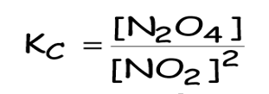
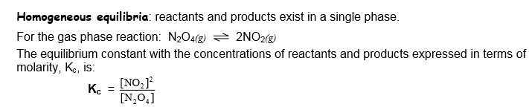
Homogeneous & Heteroenous Equilibria

Slide 28

Heterogeneous Equilibria and Solvents in Homogeneous Equilibria
Heterogeneous equilibria: reactants and products are present in more than one phase.
pure solids and liquids: concentrations of pure solids and liquids are fixed by their density and molar mass (both constants) and do not vary with the amount.
Thus, the concentrations of solids and liquids are incorporated in the Kc value; they are not part of the variable Kc expression:

Slide 29
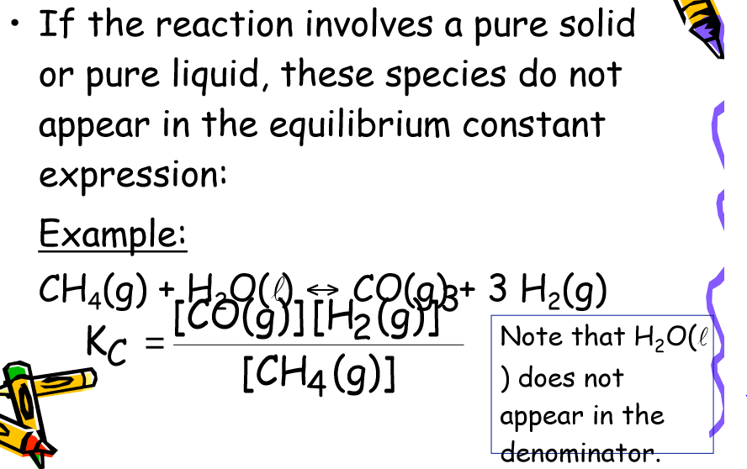
Homogeneous & Hetroenou Equilibria

Slide 30
Heterogeneous equilibria
Omit concentration terms for solids and liquids from Kc and Kp expressions; only include terms for gases (g) and aqueous substances (aq).

Slide 31

Example. For N2(g) + 3H2(g) 2NH3(g), does the equilibrium shift left or right if the pressure is increased?

Slide 32

Gas Phase Expressions can also be expressed by Kp
⇒ The Kp expression is written using equilibrium partial pressures of reactants & products. For the reaction given above, the Kp expression is:
Worked out Examples: For: H2 + I2 ↔ 2HI, does the equilibria shift left or right if we: a) add H2? b) remove I2?
a)
b)

Slide 33


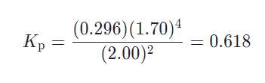
finding Kp​, from partial pressures
Example 1: finding Kp​, from partial pressures
Let's try finding Kp​, for the following gas-phase reaction:
We know the partial pressure for each component at equilibrium for some temperature T, Given that P_{N2O5} = 2.00 atm, P_{O2} = 0.296 atm, P_{NO2} = 1.70 atm. A temperature T, what is K_{p} for the reaction?
Solution: At temperature T, what is Kp​, for this reaction?
First we can write the Kp​ expression for our balanced equation:
We can now solve for Kp​, by plugging in the equilibrium partial pressures in the equilibrium expression:

Slide 34
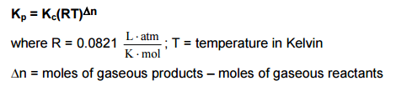
Kp is related to Kc
Since pressure and molarity are related by the Ideal Gas Law, the following equation relates Kp and Kc:
⇒ Note that Kc = Kp when the number of gas molecules are the same on both sides.

Slide 35
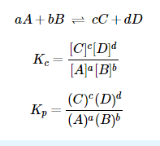
Kc and Kp

Slide 36
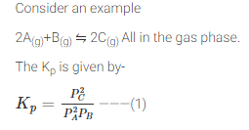
Ideal Gas Equation
Each of these ideal gas molecules behaves similarly. So for each of them,
PV = nRT
On rearranging we get-

Slide 37


Substituting these in equation (1)

Slide 38
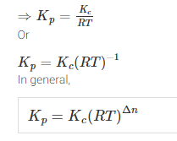
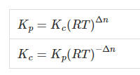

Slide 39

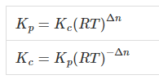
Where, Δn represents the change in the number of moles of gas molecules. [That is Δn = product – reactant in moles only for gas molecules]
When the change in the number of moles of gas molecules is zero, that is Δn = 0
In general, for any chemical reactions of gas molecules relation between K_{p} And K_{c} is-

Slide 40

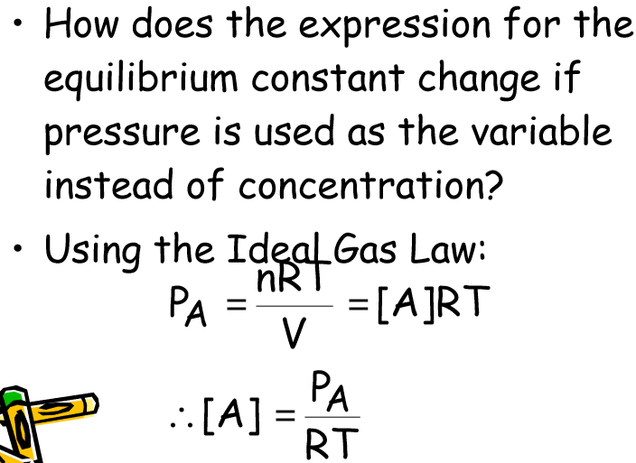

Slide 41



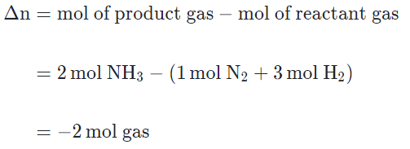
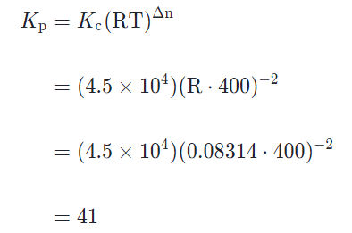

Example 2: finding Kp​, from Kc​.
Now let's look at a different reversible reaction:

Slide 42

WORKED OUT EXAMPLES

Slide 43
Le Chatelier's Principle
Le Chatelier's principle states that if a dynamic equilibrium is disturbed by changing the conditions, the position of equilibrium shifts to counteract the change to reestablish an equilibrium.
If a chemical reaction is at equilibrium and experiences a change in pressure, temperature, or concentration of products or reactants, the equilibrium shifts in the opposite direction to offset the change.
This page covers changes to the position of equilibrium due to such changes and discusses briefly why catalysts have no effect on the equilibrium position.

Slide 44
Recall factors that Le Chatelier’s principle states will affect the equilibrium of a system
Key Points
Le Chatelier’s principle can be used to predict the behavior of a system due to changes in pressure, temperature, or concentration.
Le Chatelier’s principle implies that the addition of heat to a reaction will favor the endothermic direction of a reaction as this reduces the amount of heat produced in the system.
Increasing the concentration of reactants will drive the reaction to the right, while increasing the concentration of products will drive the reaction to the left.

Slide 45
Changes in Volume and Pressure
Because the pressure of gases is related directly to the concentration by P = n/V,
changing the pressure by increasing/decreasing the volume of a container will disturb an equilibrium system.
⇒ If P increases (V decreases), the system shifts to the side with a smaller number of gas molecules (this effectively reestablishes equilibrium by decreasing the pressure).
⇒ If P decreases (V increases), the system shifts to the side with a greater number of gas molecules.

Slide 46

Changes in Temperature
Heat can be considered a reactant in an endothermic rxn and a product in an exothermic rxn. Heat can be considered a reactant in an endothermic rxn and a product in an exothermic rxn.

Slide 47

Changes in Temperature

Slide 48
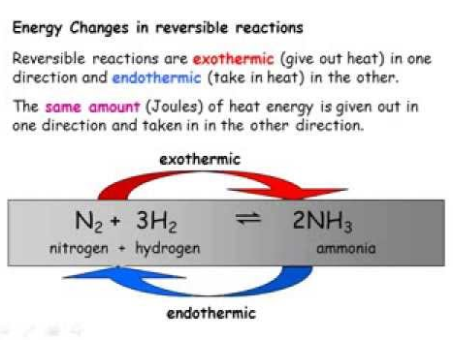

Slide 49
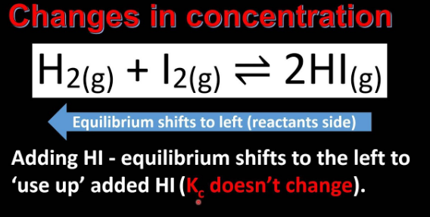

Slide 50
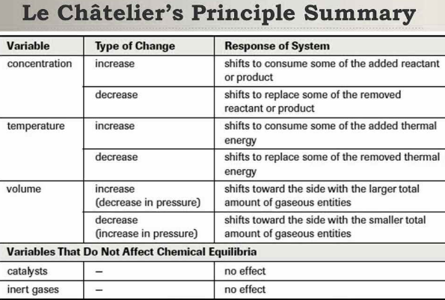

Slide 51
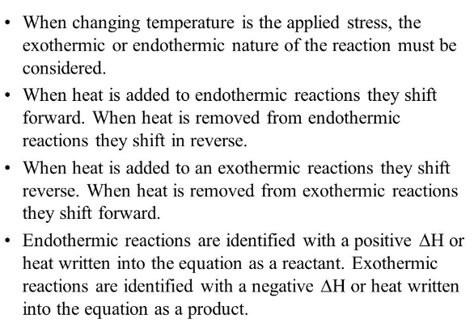
Le Chatelier’s Principle and Chemical Equlibrium

Slide 52
Effect of a Catalyst
Choosing Optimum Conditions
Le Chateliers principle can be used to select optimum conditions to form a substance. e.g. To form more NH3, predict the optimum conditions for temperature and pressure.

Slide 53


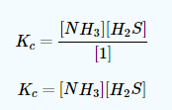
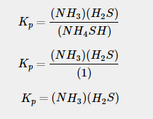
Example 1: Thermal Decomposition of NH4SH(s)NH4SH(s)
This also is related to K_{sp}
but since NH4SHNH4SH is a solid, we get:

Slide 54
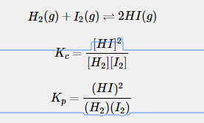
Example 2: Hydrogen and Iodine
Consider the double replacement reaction of hydrogen and iodine gas:

Slide 55
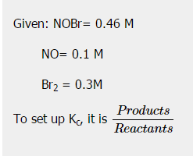
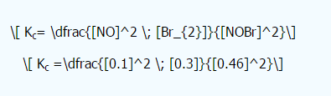


Example 3

